Slide 1
GreensGo:
Fully Autonomous
Greenhouse
Final Presentation
Notes:
GreensGo a fully autonomous Greenhouse

Slide 2
Demo & Sub-System Breakdown
Agenda
01
Introduction & Background
02
Quick look into problem and our solution
A video demo showing how the system works
Breaking the entire system down in sections
03
Value & Usage
04
Future Possibilities
What we hope to add to the market
How the data is used
What we hope to do in the future
Notes:
On the Agenda we have an introduction and background giving a quick look into the problem and solution.
A quick Demo and system breakdown
Value and usage section
And the future possibilities of GreensGo

Slide 3
Background
The future is what we make it
We as a group of final years were tasked to design and build a system that can help the United Nations #Envision2030 goals.
2030 the 17 SDG must be achieved
Goal: Zero Hunger.
Expensive Food
Autonomous Greenhouse
Notes:
We as a group of final years were tasked to design and build a system that can help the United Nations #Envision2030 goals.
The United Nations proposed that by 2030 the 17 SDG must be achieved
We chose the 2nd Goal: Zero Hunger.
The problem is that many people struggle to get food because it is expensive especially in developing countries.
That is why we believe that a greenhouse can provide a family with an effective way to produce food and tackling the 2nd SDG is the process.

Slide 4
Introduction
What innovation can achieve
We believe a fully autonomous greenhouse that is:
cheap
easy
is a solution to the second SDG:
Zero Hunger.
The system will support a
modular design
that enables it to be
scalable.
Our goal is to design a
small yet effective
greenhouse that is
fully autonomous
cheap to build and easy to assemble that can provide production
365 days
of the year in a
controlled environment.
Notes:
We believe a fully autonomous greenhouse that is:
Cheap to build and easy to assemble is a solution to the second SDG:
Zero Hunger.
The system will support a
modular design
that enables it to be
scalable.
Our goal is to design a
small yet effective
greenhouse that is
fully autonomous
cheap to build and easy to assemble that can provide production
365 days
of the year in a
controlled environment.

Slide 5
Demo

Slide 6
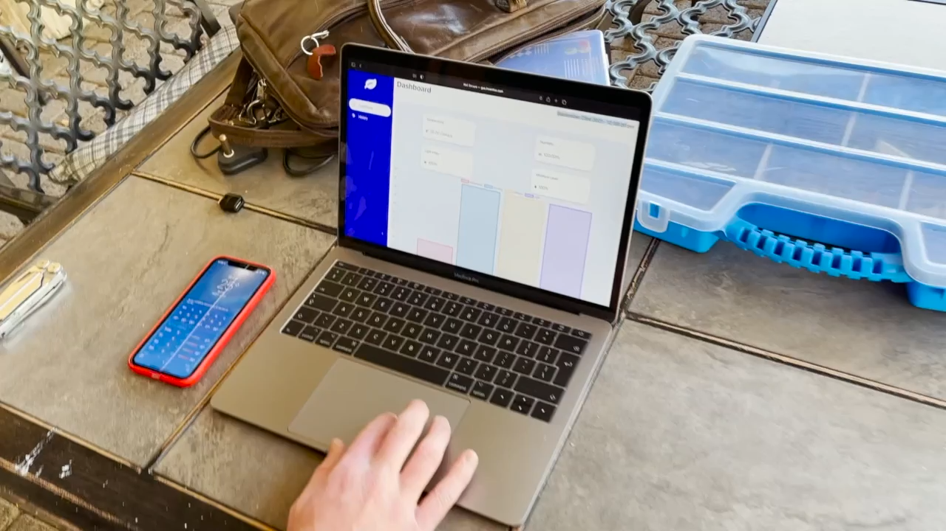

Slide 7
Sub-System Breakdown
Frontend – React
Visual representation
Interaction
Frontend
API - Connections
API
Communication
Middleman
Backend
Backend - Server
Hardware
Transmits
Handles Connections
Hardware
Hardware - Node
Retrieving Data
Sending Data
Hardware - Arduino
Capture Data
Controlling Green house
Notes:
The system consists out of 5 sub-systems.
The frontend, the API, the Backend, the Node, and the Arduino
Frontend: The frontend provides a visual representation of the data and gives the user a platform to interact with.
API: The API is the middleman between the database and the frontend.
Backend: The backend server transmits the data from the Node in a readable format to the database. Handles hardware connections.
Node: The Node is responsible for getting the data from the Arduino and sending it to the backend server.
Arduino and sensors: The Arduino is responsible for capturing data from the sensors inside the greenhouse and controlling it.

Slide 8
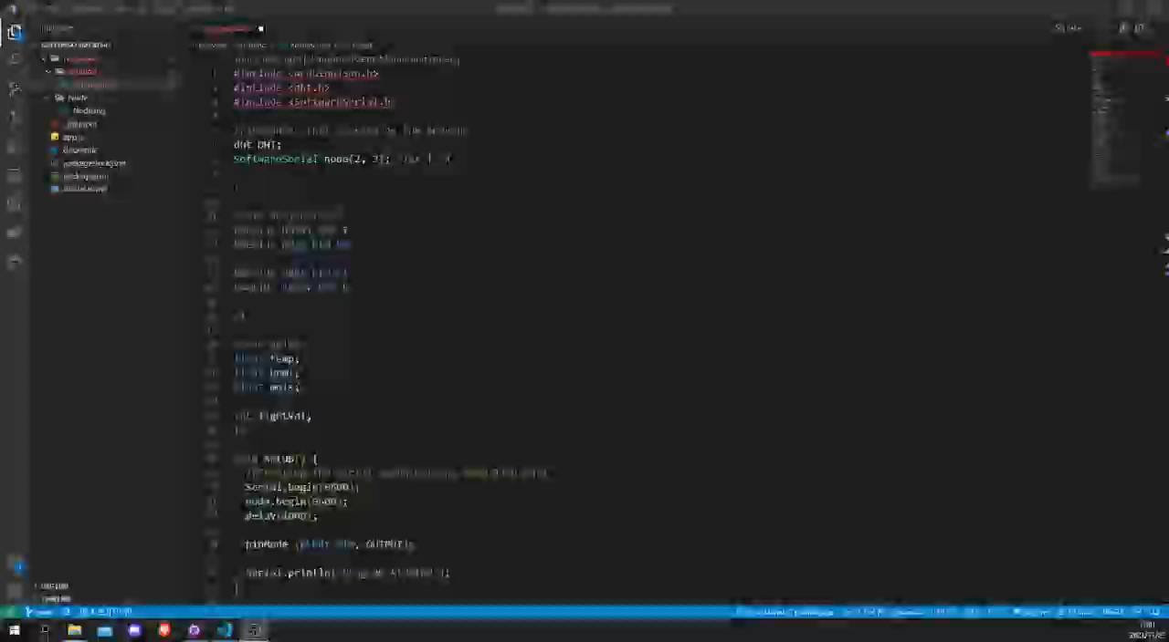
Hardware - Arduino

Slide 9
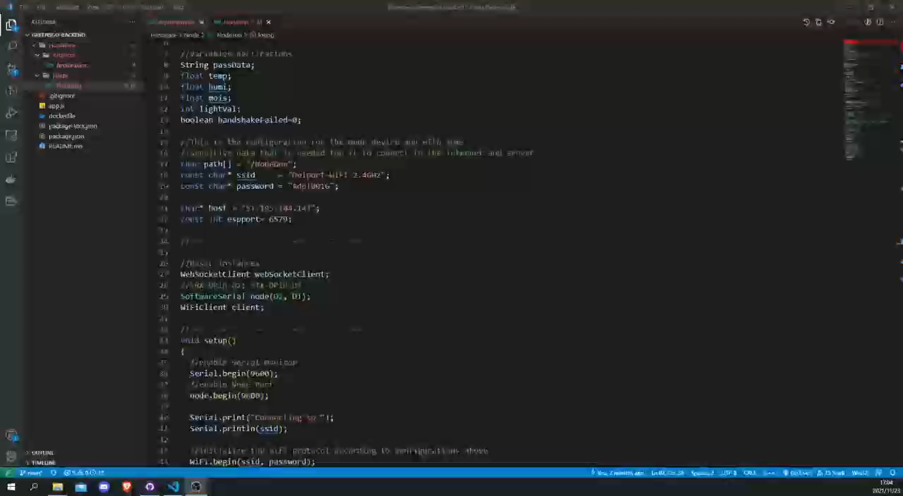
Hardware - Node

Slide 10
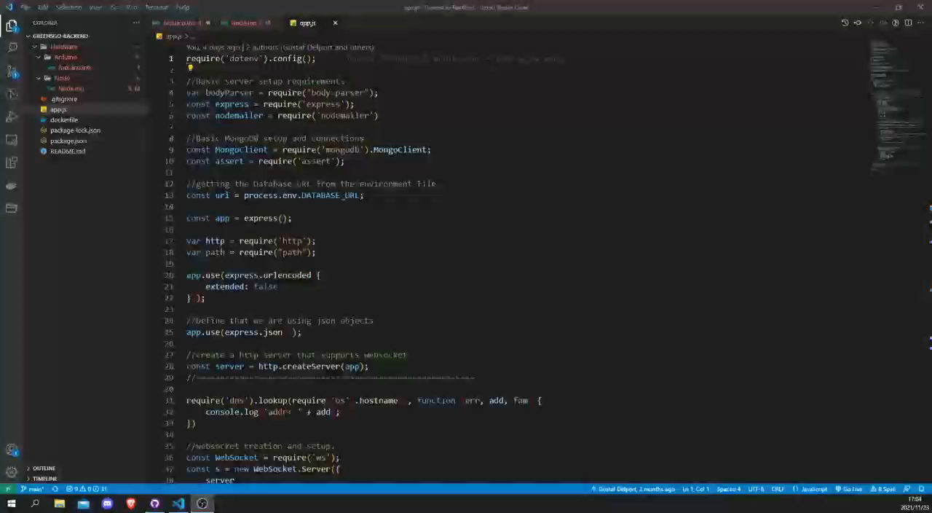
Backend - Server

Slide 11
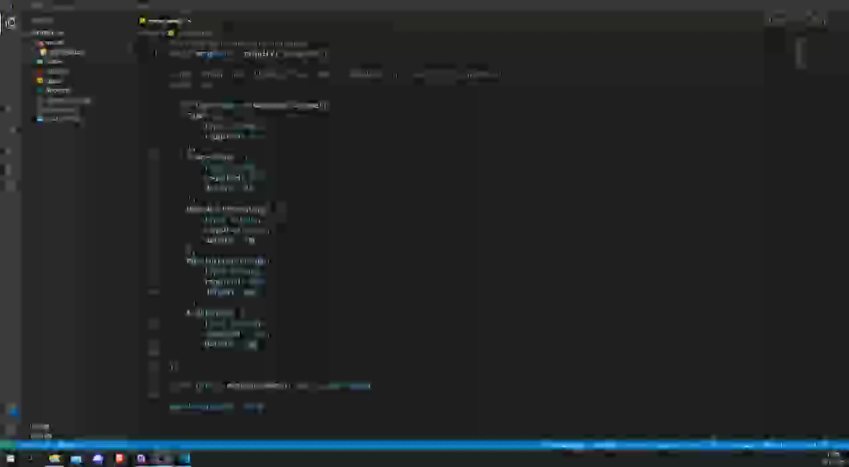
API - Connections

Slide 12
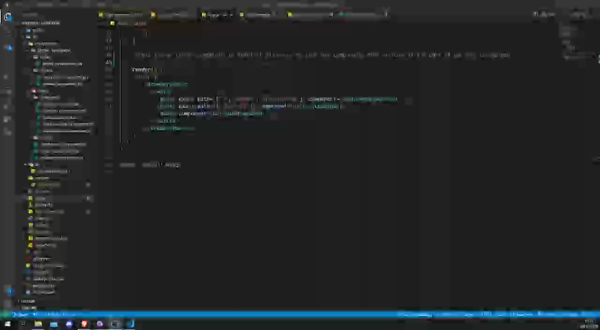
Frontend - React

Slide 13
What Makes Us Different?
Cheap
Easy
Our system is cheap to build costing less then R1500 per greenhouse.
The greenhouse is simple to build and even simpler to connect.
We shine bright.
Modular
Real-Time
If a single system is not enough you can add new ones all the time, the app is built that way.
Data is in real-time giving you active insight and giving autonomy instantly.
Notes:
What makes us different from existing systems and companies.
Well 4 key words:
Cheap , Modular, Easy and Real-Time
Our system is cheap to build costing less then R1500 per greenhouse.
The greenhouse is simple to build and even simpler to connect.
If a single system is not enough you can add new ones all the time, the app is built that way.
Data is in real-time giving you active insight and giving autonomy instantly.

Slide 14
What We Can Do With Data
Diagnose
Plan
diagnose
potential problems
Feedback
Better yields
Innovate
Share
AI
Smart recommendations
network
Payed
knowledge
Notes:
What can you as a customer do with the data gathered?
You as a customer can
Diagnose:
The data that is retrieved can be used by farmers to
diagnose
their current operations and identify
potential problems
Innovate:
AI
Can certainly be used on the data to give the household/farmer
Smart recommendations
on what needs to be done and create a
network
of information
Plan:
The data gives
feedback
and a farmer can decide what needs to be done in order to get
better yields
Share
Why hold data when you could be
payed
for sharing data instantly and bettering
knowledge
across a community or country.

Slide 15
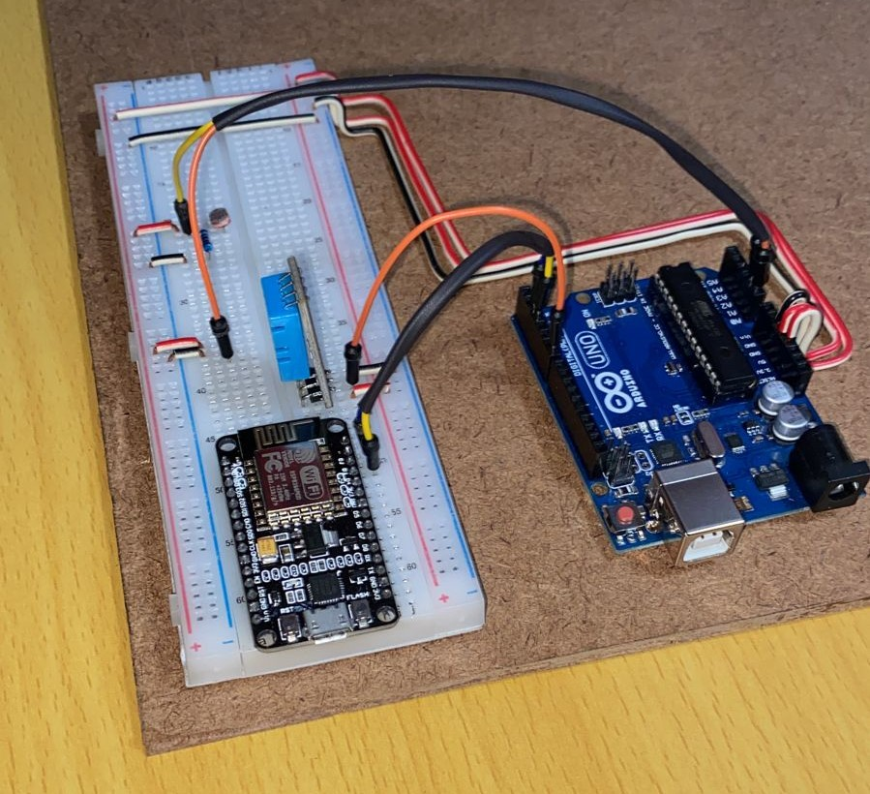
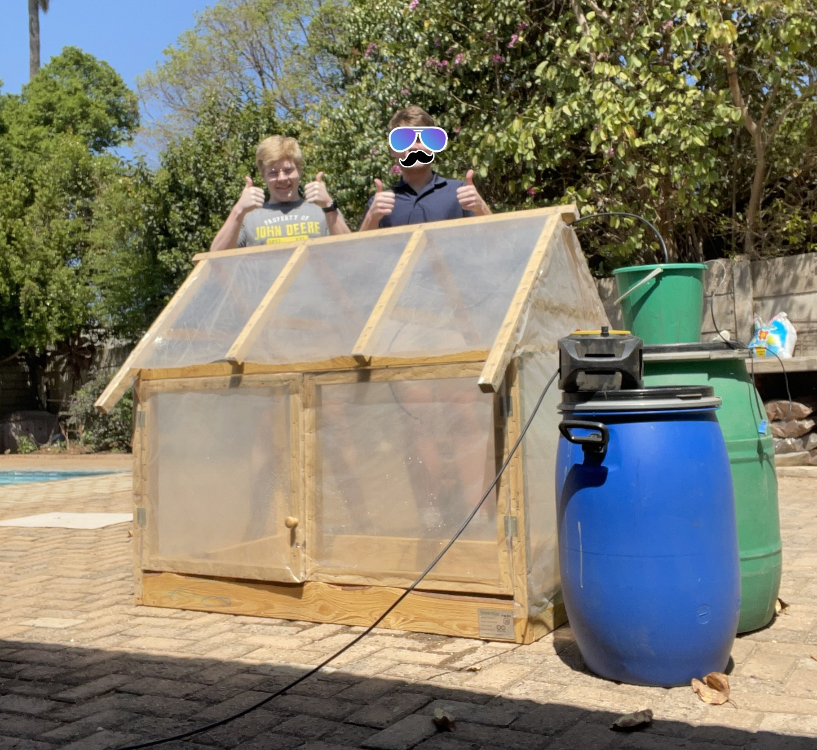
Notes:
Talk About design

Slide 16
Future Possibilities
An improved Cooling system
Ideas
Grow
Potential Investors
a louver system
improve ventilation
sell or invest
Companies
environmentally friendly
Make smaller, more modern
Data Capture
appealing to the eye.
expand
improvements within the project.
Innovate
Expand Knowledge
Notes:
What is the future for this system and GreensGo
We want to improve on the cooling System:
Currently, we are using natural airflow. A fan and a louver system can improve ventilation
We want to make the design smaller and Modern:
We are going to admit our design is not the sleekest we would really like to make the device more appealing to the eye.
We Want to attract investors:
Our plan and idea of GreensGo can be sold or invested into companies that are focused on environmentally friendly projects
General Improvements:
From the live feed, we receive about the conditions and growth of items within the greenhouse we can expand further or make improvements within the project.

Slide 17
THANK YOU

